Slide 1
Prepared by Jana Kerbaj
-Computer and Communications Engineering Student at the Lebanese American University (LAU)
-Innovation Officer at Park Innovation

Slide 2
10 mins Recap on Previously Covered Material

Slide 3
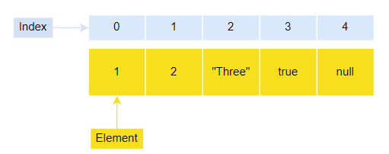
Introduction to JavaScript Arrays
In JavaScript, an array is an ordered list of values. Each value is called an element specified by an index:
A JavaScript array has the following characteristics:
First, an array can hold values of mixed types. For example, you can have an array that stores elements with the types number, string, boolean, and null.
Second, the size of an array is dynamic and auto-growing. In other words, you don’t need to specify the array size up front.

Slide 4
Creating JavaScript Arrays
JavaScript provides you with two ways to create an array. The first one is to use the Array constructor as follows:
The scores array is empty, which does hold any elements.
If you know the number of elements that the array will hold, you can create an array with an initial size as shown in the following example:

Slide 5
Creating Arrays
To create an array and initialize it with some elements, you pass the elements as a comma-separated list into the Array() constructor.
For example, the following creates the scores array that has five elements (or numbers):
Note that if you use the Array() constructor to create an array and pass a number into it, you are creating an array with an initial size.

Slide 6
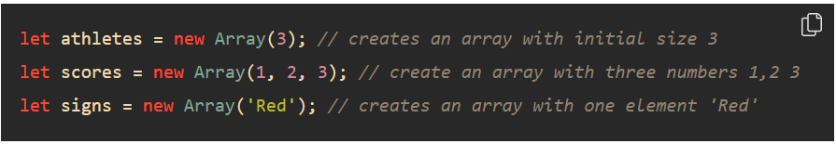
Creating Arrays
However, when you pass a value of another type like string into the Array() constructor, you create an array with an element of that value. For example:
JavaScript allows you to omit the new operator when you use the Array() constructor. For example, the following statement creates the artists array

Slide 7
Creating Arrays
In practice, you’ll rarely use the Array() constructor to create an array.
The more preferred way to create an array is to use the array literal notation:
The array literal form uses the square brackets [] to wrap a comma-separated list of elements.
The following example creates the colors array that holds string elements:
To create an empty array, you use square brackets without specifying any element like this:

Slide 8
Recap
An array is a special variable, which can hold more than one value:
const cars = ["Saab", "Volvo", "BMW"];
Why Use Arrays?
If you have a list of items (a list of car names, for example), storing the cars in single variables could look like this:
let car1 = "Saab";
let car2 = "Volvo";
let car3 = "BMW";
However, what if you want to loop through the cars and find a specific one? And what if you had not 3 cars, but 300?
The solution is an array!
An array can hold many values under a single name, and you can access the values by referring to an index number.

Slide 9
Array Indexing
In JavaScript, arrays use numbered indexes. From left to right, index number starts from 0.
Access an element
Similar to string, array elements are accessed using square brackets to enclose the index number: arr[i].
Change array element
Contrary to string, an array is mutable, which means you can change its contents. We can assign new value to an element using array index:
arr[i] = new value
We can replace an element, or add a new item to the array.

Slide 10
Examples
let fruits = ["Apple", "Orange", "Banana"];
// access array elements
alert( fruits[0] ); // Apple
alert( fruits[1] ); // Orange
alert( fruits[2] ); // Banana
// change an item
fruits[1] = 'Bear';
// add an new item
fruits[3] = 'Monkey';
// changed array
console.log(fruits); // ["Apple", "Bear", "Banana", "Monkey"]
// last element:
console.log(fruits[3]); // Monkey
console.log(fruits[fruits.length - 1]); // Monkey (also the last item)
console.log(fruits.length); // 4

Slide 11
The ‘length’ Property
Similar to string, the length property has the array length, it simply returns the total number of elements in the array:
let dates = ['Mon', 'Tue', 'Wed', 'Thu', 'Fri', 'Sat', 'Sun'];
alert(dates.length); // 7

Slide 12
Few Examples
const cars = ["Saab", "Volvo", "BMW"];
let car = cars[0];
Accessing the first array element:
const fruits = ["Banana", "Orange", "Apple","Mango"];
let fruit = fruits[0];
Accessing the last array element:
const fruits = ["Banana", "Orange", "Apple", "Mango"];
let fruit = fruits[fruits.length - 1];

Slide 13
Modifying Arrays
To change an array element in JavaScript, use the element index.
See the following code.
let arr = new Array(4, 9, 16);
console.log('Before modify: ', arr);
arr[0] = 25;
arr[1] = 36;
arr[2] = 49
console.log('After Modify: ', arr);

Slide 14
Example
This statement changes the value of the first element in cars:
cars[0] = "Opel";
Example
const cars = ["Saab", "Volvo", "BMW"];
cars[0] = "Opel";

Slide 15
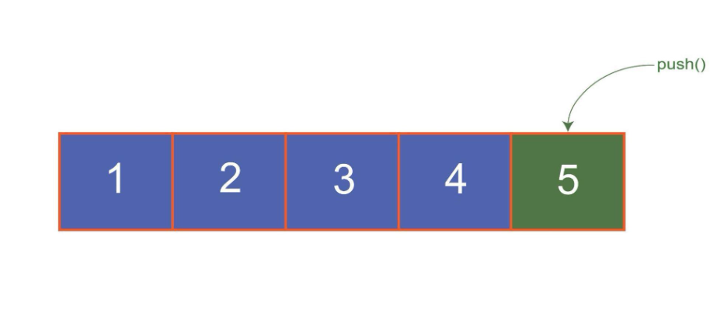
Push and Pop- Arrays
When working with arrays, we frequently need to add or remove elements. The push() and pop() methods come to the rescue in this situation. We’ll go over what the push() and pop() functions in JavaScript are, as well as some examples to help you understand them better.
push() is used to add an element/item to the end of an array.

Slide 16
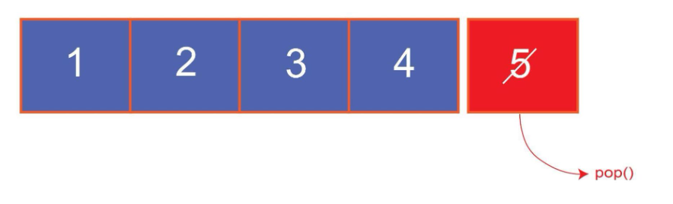
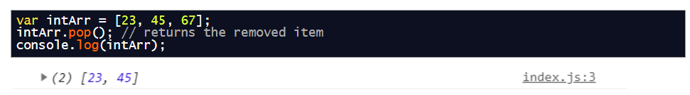
Push and Pop
The pop() function is used to delete the last element/item of the array.
How to use the pop() method in JavaScript
Suppose we have an array of numbers and we want to remove the last element from it. The code from removing an element from the end of the array would go like this:

Slide 17
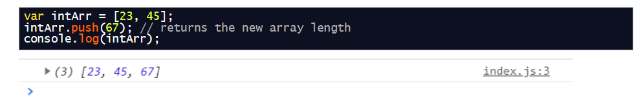
Push and Pop
How to use the push() method in JavaScript
Similarly, if we want to add an element at the end of an array, the code for pushing or adding an element would go like this:
Conclusion
The pop() method in JavaScript removes an item from the end of an array, whereas the push() method adds an item to the end of an array. The returning value of the pop() method is the item that is removed from the array. The returning value of the push() method is the number of elements in the array after the new element has been added. These two methods are used a lot when working with arrays in JavaScript.

Slide 18
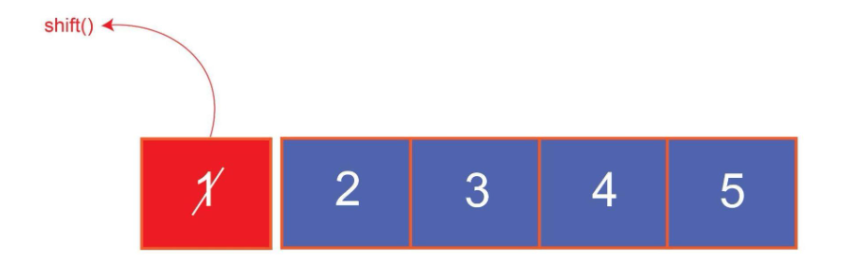
Shift and Unshift
While working with arrays, we often need to add or remove elements in an array. For fulfilling this need, shift() and unshift() methods come to the rescue. In this post, we will have a brief discussion about shift() and unshift() functions in JavaScript and a couple of examples to have a profound understanding of these functions.
The shift() method is used to remove an element/item from the starting point of an array.

Slide 19
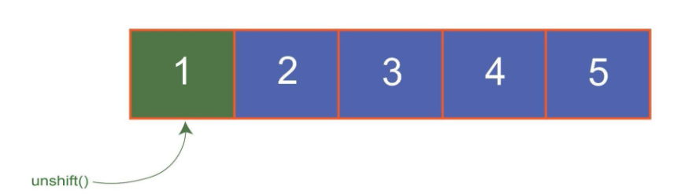
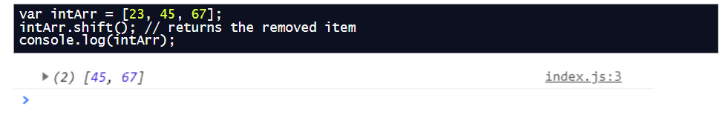
Shift and Unshift
The unshift() method is used to add an element/item to the starting point of an array.
How to use shift() method in JavaScript
Suppose we have an array of numbers and we want to remove the first element from it. The code from removing an element from the beginning of the array would go like this:

Slide 20
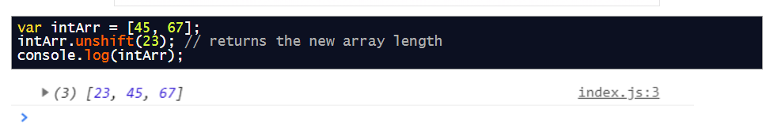
Shift and Unshift
How to use unshift() method in JavaScript
Similarly, if we want to add an element at the start of an array, the code for adding an element would go like this:
The shift() method in JavaScript removes an item from the beginning of an array and shifts every other item to the previous index, whereas the unshift() method adds an item to the beginning of an array while shifting every other item to the next index. The returning value of the shift() method is the item that is removed from the array, and the unshift() method returns the new length of the array. These two methods are used a lot when working with arrays in JavaScript.

Slide 21
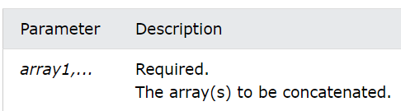
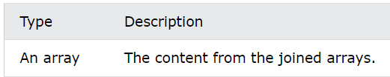
Concat
The concat() method concatenates (joins) two or more arrays.
The concat() method returns a new array, containing the joined arrays.
The concat() method does not change the existing arrays.
Syntax:
array1.concat(array2, array3, ..., arrayX)
Parameters:
Return Value:

Slide 22
Concat Examples
Join two arrays:
const arr1 = ["Cecilie", "Lone"];
const arr2 = ["Emil", "Tobias", "Linus"];
const children = arr1.concat(arr2);
→Cecilie,Lone,Emil,Tobias,Linus
Join three arrays:
const arr1 = ["Cecilie", "Lone"];
const arr2 = ["Emil", "Tobias", "Linus"];
const arr3 = ["Robin"];
const children = arr1.concat(arr2, arr3);
→Cecilie,Lone,Emil,Tobias,Linus,Robin
Concatenate strings and numbers:
const arr1 = ["Cecilie", "Lone"];
const arr2 = [1, 2, 3];
const arr3 = arr1.concat(arr2);
→Cecilie,Lone,1,2,3

Slide 23
Index and Includes
ES2016 Specifications included the includes() method for Array data structure. The includes() method check if an array includes a certain element, returning true or false as appropriate. But in ES5 we are used to performing operations like this with indexOf() method.
Using includes() method.
const array = [1,2,3,4,5,6]; if(array.includes(4) ){
console.log("true 4 was found in the array")// true 4 was found in the array
}
Let's perform the same operation with indexOf() method.
const array = [1,2,3,4,5,6]; if(array.indexOf(4) > -1 ){
console.log("true 4 was found in the array")// true 4 was found in the array
}

Slide 24
Index and Includes
Using includes() method to check for NaN
const array = [NaN]; if (array.includes(NaN)){
console.log("true. NAN was found in the array");// true. NAN was found in the array
}
This is where things begin to fall apart with indexOf() method.
const array = [NaN];
if (array.indexOf(NaN) == -1){ console.log("NaN not found in the array");//NaN not found in the array
}
Checking for undefined with the includes() method.
const array = [, , , ,]; if(array.includes(undefined)){
console.log("true array elements are undefined");// true array elements are undefined
}
Let's see how indexOf() method will handle this operation.
const array = [, , , ,]; if(!array.indexOf(undefined) == -1 ){
console.log("true. array elements are undefined");
}else {
console.log("Sorry can't find undefined");// Sorry can't find undefined
}

Slide 25
Reverse
The reverse() method reverses the order of the elements in an array.
The reverse() method overwrites the original array.
Syntax: array.reverse()
Return Value: The array after it has been reversed.
Example:
const fruits = ["Banana", "Orange", "Apple", "Mango"];
fruits.reverse();
Output:
The Array.reverse() method reverses the order of the elements in an array.
Mango,Apple,Orange,Banana

Slide 26
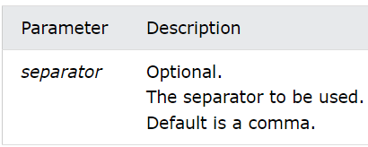
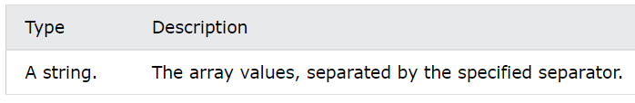
Join
Definition and Usage:
The join() method returns an array as a string.
The join() method does not change the original array.
Any separator can be specified. The default is comma
Syntax:
array.join(separator)
Parameters:
Return Value:

Slide 27
Join Examples
const fruits = ["Banana", "Orange", "Apple", "Mango"];
let text = fruits.join();
Output:
join() returns an array as a string:
Banana,Orange,Apple,Mango
Another Separator:
const fruits = ["Banana", "Orange", "Apple", "Mango"];
let text = fruits.join(" and ");
Output
join() returns an array as a string:
Banana and Orange and Apple and Mango

Slide 28
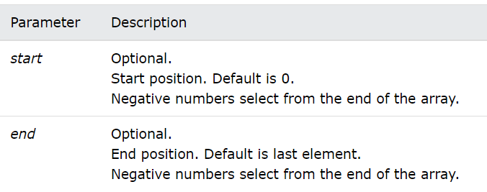
Slice
Definition and Use
The slice() method returns selected elements in an array, as a new array.
The slice() method selects from a given start, up to a (not inclusive) given end.
The slice() method does not change the original array.
Syntax
array.slice(start, end)
Parameters
Return Value
A new array containing the selected elements.

Slide 29
Slice- Examples
Select elements:
const fruits = ["Banana", "Orange", "Lemon", "Apple", "Mango"];
const citrus = fruits.slice(1, 3);
Output:
Array.slice() returns selected array elements as a new array:
Orange,Lemon
Select elements using negative values:
const fruits = ["Banana", "Orange", "Lemon", "Apple", "Mango"];
const myBest = fruits.slice(-3, -1);
Output:
Array.slice() returns selected array elements as a new array:
Lemon,Apple

Slide 30
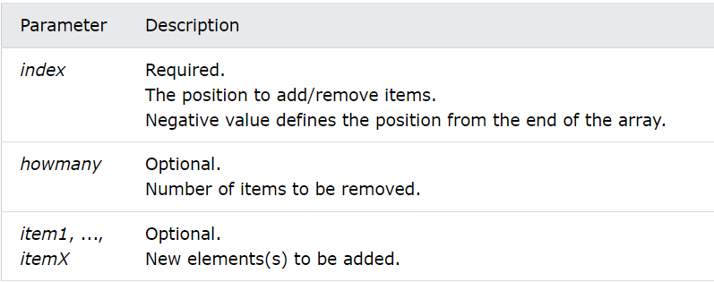
Splice
Definition and Usage
The splice() method adds and/or removes array elements.
The splice() method overwrites the original array.
Syntax
array.splice(index, howmany, item1, ....., itemX)
Parameters
Return Value
An array containing the removed items (if any).

Slide 31
Splice- Examples
At position 2, add 2 elements:
const fruits = ["Banana", "Orange", "Apple", "Mango"];
fruits.splice(2, 0, "Lemon", "Kiwi");
Output:
The Array.splice() method adds array elements:
Banana,Orange,Lemon,Kiwi,Apple,Mango
At position 2, remove 2 items:
const fruits = ["Banana", "Orange", "Apple", "Mango", "Kiwi"];
fruits.splice(2, 2);
Output:
The Array.splice() method adds and removes array elements:
Banana,Orange,Kiwi
At position 2, add new items, and remove 1 item:
const fruits = ["Banana", "Orange", "Apple", "Mango"];
fruits.splice(2, 1, "Lemon", "Kiwi");

Slide 32
Examples of Primitives and their Purposes
Null is a primitive that signifies that the value is unknown. Keep in mind that the typeof operator returns object for null due to ECMAScript’s evaluation.
Undefined is not a declared value and is not defined in any meaningful way for someone to interpret. Any variable not assigned a value belongs to this category.
Boolean refers to a logical statement with only two values: true or false.
String is a primitive that represents characters put together in words or phrases that make up text. Thus, it can be referred to as textual data.
BigInt represents integers that were possibly calculated and formed into digits of precision only limited by available system memory (arbitrary precision format). In essence, this primitive represents whole numbers larger than 253 - 1: the largest number JavaScript can reliably represent.

Slide 33
Variables
var name = expression; JS
var clientName = "Connie Client";
var age = 32;
var weight = 127.4; JS
variables are declared with the var keyword (case sensitive)
types are not specified, but JS does have types ("loosely typed")
Number, Boolean, String, Array, Object, Function, Null, Undefined
can find out a variable's type by calling typeof

Slide 34
let
The let declaration declares a block-scoped local variable, optionally initializing it to a value.
let x = 1;
if (x === 1)
{ let x = 2; console.log(x);
// expected output: 2}
console.log(x);// expected output: 1
Syntax
let name1 [= value1] [, name2 [= value2]] [, ..., nameN [= valueN];
let allows you to declare variables that are limited to the scope of a block statement, or expression on which it is used, unlike the var keyword, which declares a variable globally, or locally to an entire function regardless of block scope. The other difference between var and let is that the latter is initialized to a value only when a parser evaluates it

Slide 35
let vs var
Unlike var, let begins declarations, not statements. That means you cannot use a lone let declaration as the body of a block (which makes sense, since there's no way to access the variable).
if (true) let a = 1; // SyntaxError: Lexical declaration cannot appear in a single-statement context

Slide 36
NaN & Infinity
The value NaN in JavaScript stands for “not a number”. It mainly indicates that parsing a string has gone wrong:
> Number("xyz")
NaN
NaN has some Koan-like qualities. Its name is “not a number”, but it’s also not not a number (triggered by a tweet by Ariya Hidayat):
> NaN !== NaN
true
Yet, its type is “number”.
> typeof NaN
'number'

Slide 37
NaN
Detecting NaN
NaN is the only JavaScript value that is not equal to itself. Without equality at your disposal, you have to use the global function isNaN() to detect it.
> isNaN(NaN)
true
isNaN(): It coerces its argument to number and will thus even return true for strings that cannot be converted to numbers:
> Number("xyz")
NaN
> isNaN("xyz")
true
For the same reason, isNaN will also return true for many objects:
> Number({})
NaN
> isNaN({})
true
> Number(["xzy"])
NaN
> isNaN(["xzy"])
true

Slide 38
Infinity
Infinity
Division by 0 gives you another special value:
> 3/0
Infinity
You can’t play positive and negative infinity against each other:
> Infinity - Infinity
NaN
It also turns out that “beyond infinity” is still infinity:
> Infinity + Infinity
Infinity
> 5 * Infinity
Infinity

Slide 39

Math in JS
Everybody loves math?
Okay, maybe not. Some of us like math, some of us have hated math ever since we had to learn multiplication tables and long division in school, and some of us sit somewhere in between the two. But none of us can deny that math is a fundamental part of life that we can't get very far without. This is especially true when we are learning to program JavaScript (or any other language for that matter) — so much of what we do relies on processing numerical data, calculating new values, and so on, that you won't be surprised to learn that JavaScript has a full-featured set of math functions available.
We will discuss only the basic parts that you need to know now.

Slide 40
Introducing Numbers
Types of numbers
In programming, even the humble decimal number system that we all know so well is more complicated than you might think. We use different terms to describe different types of decimal numbers, for example:
Integers are floating-point numbers without a fraction. They can either be positive or negative, e.g. 10, 400, or -5.
Floating point numbers (floats) have decimal points and decimal places, for example 12.5, and 56.7786543.
Doubles are a specific type of floating point number that have greater precision than standard floating point numbers (meaning that they are accurate to a greater number of decimal places).
We even have different types of number systems! Decimal is base 10 (meaning it uses 0–9 in each column), but we also have things like:
Binary — The lowest level language of computers; 0s and 1s.
Octal — Base 8, uses 0–7 in each column.
Hexadecimal — Base 16, uses 0–9 and then a–f in each column. You may have encountered these numbers before when setting colors in CSS.

Slide 41
Introducing Numbers
JavaScript only has one data type for numbers, both integers and decimals — you guessed it, Number. This means that whatever type of numbers you are dealing with in JavaScript, you handle them in exactly the same way.
Note: Actually, JavaScript has a second number type, BigInt, used for very, very large integers. But for the purposes of this course, we'll just worry about Number values.

Slide 42
Introducing Numbers
Let's quickly play with some numbers to reacquaint ourselves with the basic syntax we need. Enter the commands listed below into your console:
First of all, let's declare a couple of variables and initialize them with an integer and a float, respectively, then type the variable names back in to check that everything is in order:
const myInt = 5;
const myFloat = 6.667;
myInt;
myFloat;
Number values are typed in without quote marks — try declaring and initializing a couple more variables containing numbers before you move on.
Now let's check that both our original variables are of the same datatype. There is an operator called typeof in JavaScript that does this. Enter the below two lines as shown:
typeof myInt;
typeof myFloat;
You should get "number" returned in both cases — this makes things a lot easier for us than if different numbers had different data types, and we had to deal with them in different ways.

Slide 43
Introducing Numbers
Useful Number methods
The Number object, an instance of which represents all standard numbers you'll use in your JavaScript, has a number of useful methods available on it for you to manipulate numbers. We don't cover these in detail in this article because we wanted to keep it as a simple introduction and only cover the real basic essentials for now; however, once you've read through this module a couple of times it is worth going to the object reference pages and learning more about what's available.
For example, to round your number to a fixed number of decimal places, use the toFixed() method. Type the following lines into your browser's console:
const lotsOfDecimal = 1.766584958675746364;
lotsOfDecimal;
const twoDecimalPlaces = lotsOfDecimal.toFixed(2);
twoDecimalPlaces;

Slide 44
Converting to number data types
Sometimes you might end up with a number that is stored as a string type, which makes it difficult to perform calculations with it. This most commonly happens when data is entered into a form input, and the input type is text. There is a way to solve this problem — passing the string value into the Number() constructor to return a number version of the same value.
For example, try typing these lines into your console:
let myNumber = '74';
myNumber += 3;
You end up with the result 743, not 77, because myNumber is actually defined as a string. You can test this by typing in the following:
typeof myNumber;
To fix the calculation, you can do this:
let myNumber = '74';
myNumber = Number(myNumber) + 3;
The result is then 77, as initially expected.

Slide 45
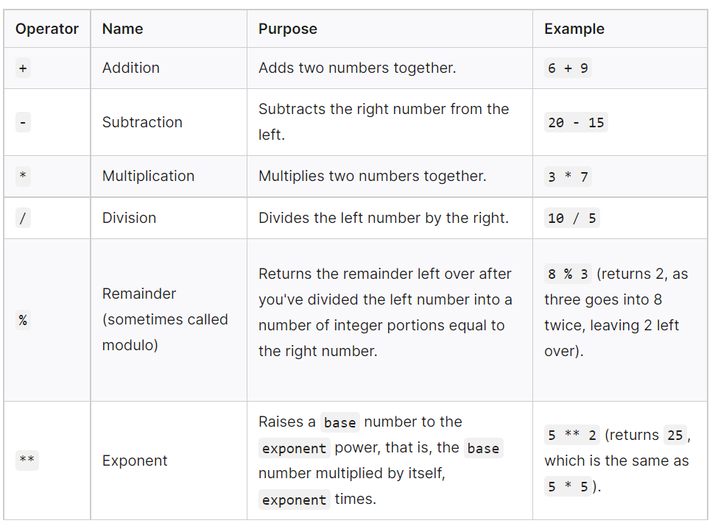
Arithmetic Operators

Slide 46
Examples
Try entering the examples below into your JavaScript console to familiarize yourself with the syntax.
First try entering some simple examples of your own, such as
10 + 7
9 * 8
60 % 3
You can also try declaring and initializing some numbers inside variables, and try using those in the sums — the variables will behave exactly like the values they hold for the purposes of the sum. For example:
const num1 = 10;
const num2 = 50;
9 * num1;
num1 ** 3;
num2 / num1;
Last for this section, try entering some more complex expressions, such as:
5 + 10 * 3;
num2 % 9 * num1;
num2 + num1 / 8 + 2;

Slide 47
Operator Precedence
Parts of this last set of calculations might not give you quite the result you were expecting; the section below might well give the answer as to why.
Let's look at the last example from above, assuming that num2 holds the value 50 and num1 holds the value 10 (as originally stated above):
num2 + num1 / 8 + 2;
As a human being, you may read this as "50 plus 10 equals 60", then "8 plus 2 equals 10", and finally "60 divided by 10 equals 6".
But the browser does "10 divided by 8 equals 1.25", then "50 plus 1.25 plus 2 equals 53.25".
This is because of operator precedence — some operators are applied before others when calculating the result of a calculation (referred to as an expression, in programming).
Operator precedence in JavaScript is the same as is taught in math classes in school — multiply and divide are always done first, then add and subtract (the calculation is always evaluated from left to right).
If you want to override operator precedence, you can put parentheses round the parts that you want to be explicitly dealt with first. So to get a result of 6, we could do this:
(num2 + num1) / (8 + 2);
Try it and see.

Slide 48
Operator Precedence
Sometimes you'll want to repeatedly add or subtract one to or from a numeric variable value. This can be conveniently done using the increment (++) and decrement (--) operators. guessCount++;
Let's try playing with these in your console. For a start, note that you can't apply these directly to a number, which might seem strange, but we are assigning a variable a new updated value, not operating on the value itself. The following will return an error:
3++;
So, you can only increment an existing variable. Try this:
let num1 = 4;
num1++;
Okay, strangeness number 2! When you do this, you'll see a value of 4 returned — this is because the browser returns the current value, then increments the variable. You can see that it's been incremented if you return the variable value again:
num1;
The same is true of -- : try the following
let num2 = 6;
num2--;
num2;

Slide 49
Operator Precedence
You can make the browser do it the other way round — increment/decrement the variable then return the value — by putting the operator at the start of the variable instead of the end. Try the above examples again, but this time use ++num1 and --num2.
Do it yourself, then compare the results and conclude!

Slide 50
Assignment Operators
Assignment operators are operators that assign a value to a variable. We have already used the most basic one, =, loads of times — it assigns the variable on the left the value stated on the right:
let x = 3; // x contains the value 3
let y = 4; // y contains the value 4
x = y; // x now contains the same value y contains, 4
But there are some more complex types, which provide useful shortcuts to keep your code neater and more efficient. The most common are listed below:

Slide 51
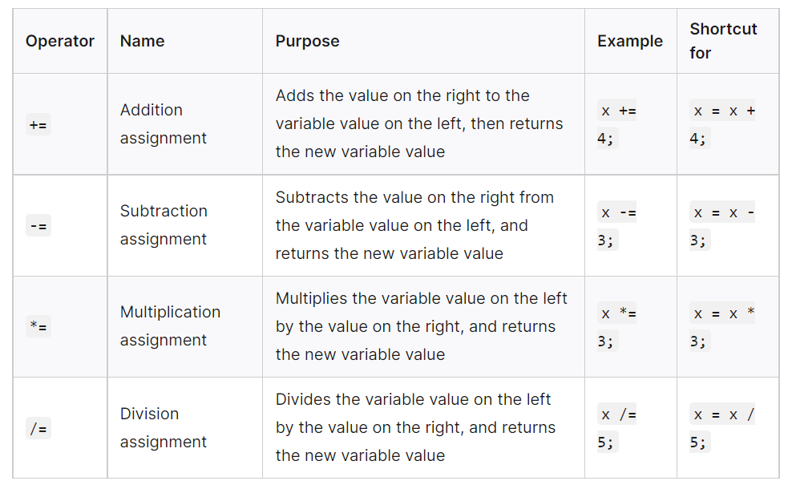
Assignment Operators

Slide 52
Examples
Try typing some of the above examples into your console, to get an idea of how they work. In each case, see if you can guess what the value is before you type in the second line.
Note that you can quite happily use other variables on the right-hand side of each expression, for example:
let x = 3; // x contains the value 3
let y = 4; // y contains the value 4
x *= y; // x now contains the value 12

Slide 53
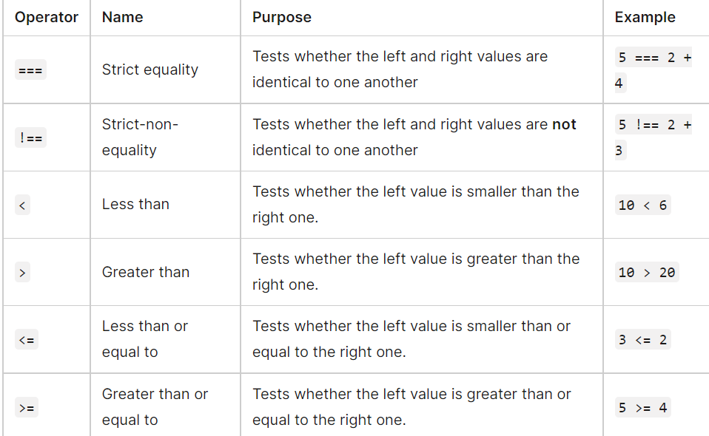
Comparison Operators
Sometimes we will want to run true/false tests, then act accordingly depending on the result of that test — to do this we use comparison operators.

Slide 54
Intro to Booleans
A JavaScript Boolean represents one of two values: true or false.
Boolean Values
Very often, in programming, you will need a data type that can only have one of two values, like
YES / NO
ON / OFF
TRUE / FALSE
For this, JavaScript has a Boolean data type. It can only take the values true or false.
The Boolean() Function
You can use the Boolean() function to find out if an expression (or a variable) is true:
Example
Boolean(10 > 9)
Or even easier:
Example
(10 > 9)
10 > 9

Slide 55
Intro to Booleans (cnt’d)
JavaScript Booleans as Objects
Normally JavaScript booleans are primitive values created from literals:
let x = false;
But booleans can also be defined as objects with the keyword new:
let y = new Boolean(false);
Example
let x = false;
let y = new Boolean(false);
// typeof x returns boolean
// typeof y returns object

Slide 56
Boolean Uses
For example, booleans can be used to:
Display the correct text label on a button depending on whether a feature is turned on or off
Display a game over message if a game is over or a victory message if the game has been won
Display the correct seasonal greeting depending what holiday season it is
Zoom a map in or out depending on what zoom level is selected

Slide 57
The Power of Words
Words are very important to humans — they are a large part of how we communicate.
Since the Web is a largely text-based medium designed to allow humans to communicate and share information, it is useful for us to have control over the words that appear on it.
HTML provides structure and meaning to our text,
CSS allows us to precisely style it, and JavaScript contains a number of features for manipulating strings, creating custom welcome messages and prompts, showing the right text labels when needed, sorting terms into the desired order, and much more.

Slide 58
Strings- The Basics
Creating a string
To start with, enter the following lines:
const string = 'The revolution will not be televised.';
console.log(string);
Just like we did with numbers, we are declaring a variable, initializing it with a string value, and then returning the value. The only difference here is that when writing a string, you need to surround the value with quotes.
If you don't do this, or miss one of the quotes, you'll get an error. Try entering the following lines:
const badString1 = This is a test;
const badString2 = 'This is a test;
const badString3 = This is a test';

Slide 59
Strings- The Basics
The following will work if you previously defined the variable string — try it now:
const badString = string;
console.log(badString);
badString is now set to have the same value as string.

Slide 60
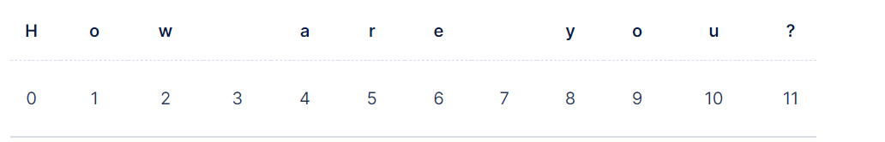
How Strings are Indexed?
Each of the characters in a string correspond to an index number, starting with 0.
To demonstrate, we will create a string with the value How are you?.

Slide 61
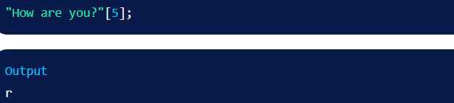
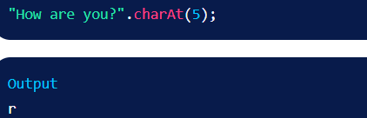
Accessing Characters
We’re going to demonstrate how to access characters and indices with the How are you? string.
Using square bracket notation, we can access any character in the string.
Example:
We can also use the charAt() method to return the character using the index number as a parameter

Slide 62
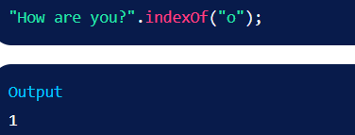
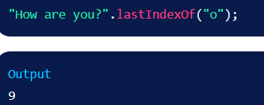
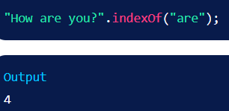
Accessing Characters
We can use indexOf() to return the index number by the first instance of a character.
lastIndexOf() is used to find the last instance.

Slide 63
Finding the length of a string
const browserType = 'mozilla';
browserType.length;
This should return the number 7, because "mozilla" is 7 characters long.

Slide 64
Testing if a string contains a substring
Sometimes you'll want to find if a smaller string is present inside a larger one (we generally say if a substring is present inside a string).
This can be done using the includes() method, which takes a single parameter — the substring you want to search for.
It returns true if the string contains the substring, and false otherwise.
const browserType = 'mozilla';
if (browserType.includes('zilla')) {
console.log('Found zilla!');
} else {
console.log('No zilla here!');
}

Slide 65
startsWith() and endsWith()
Often you'll want to know if a string starts or ends with a particular substring. This is a common enough need that there are two special methods for this: startsWith() and endsWith():
startsWith()
const browserType = 'mozilla';
if (browserType.startsWith('zilla')) {
console.log('Found zilla!');
} else {
console.log('No zilla here!');
}
endsWith()
const browserType = 'mozilla';
if (browserType.endsWith('zilla')) {
console.log('Found zilla!');
} else {
console.log('No zilla here!');
}

Slide 66
Extracting a substring from a string
You can extract a substring from a string using the slice() method. You pass it:
the index at which to start extracting
the index at which to stop extracting. This is exclusive, meaning that the character at this index is not included in the extracted substring.
For example:
const browserType = 'mozilla';
console.log(browserType.slice(1, 4)); // "ozi"
The character at index 1 is "o", and the character at index 4 is "l". So we extract all characters starting at "o" and ending just before "l", giving us "ozi".
If you know that you want to extract all of the remaining characters in a string after a certain character, you don't have to include the second parameter. Instead, you only need to include the character position from where you want to extract the remaining characters in a string. Try the following:
browserType.slice(2); // "zilla"
This returns "zilla" — this is because the character position of 2 is the letter "z", and because you didn't include a second parameter, the substring that was returned was all of the remaining characters in the string.

Slide 67
Changing Case
The string methods toLowerCase() and toUpperCase() take a string and convert all the characters to lower- or uppercase, respectively. This can be useful for example if you want to normalize all user-entered data before storing it in a database.
Let's try entering the following lines to see what happens:
const radData = 'My NaMe Is MuD';
console.log(radData.toLowerCase());
console.log(radData.toUpperCase());

Slide 68
Updating Parts of a String
You can replace one substring inside a string with another substring using the replace() method.
In this example, we're providing two parameters — the string we want to replace, and the string we want to replace it with:
const browserType = 'mozilla';
const updated = browserType.replace('moz','van');
console.log(updated); // "vanilla"
console.log(browserType); // "mozilla"
Note that replace(), like many string methods, doesn't change the string it was called on, but returns a new string. If you want to update the original browserType variable, you would have to do something like this:
let browserType = 'mozilla';
browserType = browserType.replace('moz','van');
console.log(browserType); // "vanilla"
Also note that we now have to declare browserType using let, not const, because we are reassigning it.
Be aware that replace() in this form only changes the first occurrence of the substring. If you want to change all occurrences, you can use replaceAll():
let quote = 'To be or not to be';
quote = quote.replaceAll('be','code');
console.log(quote); // "To code or not to code"

Slide 69
Single quotes vs. double quotes
In JavaScript, you can choose single quotes or double quotes to wrap your strings in. Both of the following will work okay:
const sgl = 'Single quotes.';
const dbl = "Double quotes";
console.log(sgl);
console.log(dbl);
There is very little difference between the two, and which you use is down to personal preference.
The following will return an error:
const badQuotes = 'What on earth?";
The browser will think the string has not been closed because the other type of quote you are not using to contain your strings can appear in the string. For example, both of these are okay:
const sglDbl = 'Would you eat a "fish supper"?';
const dblSgl = "I'm feeling blue.";
console.log(sglDbl);
console.log(dblSgl);
However, you can't include the same quote mark inside the string if it's being used to contain them. The following will error, as it confuses the browser as to where the string ends:
const bigmouth = 'I've got no right to take my place…';

Slide 70
Escaping characters in a string
To fix our previous problem code line, we need to escape the problem quote mark. Escaping characters means that we do something to them to make sure they are recognized as text, not part of the code. In JavaScript, we do this by putting a backslash just before the character. Try this:
const bigmouth = 'I\'ve got no right to take my place…';
console.log(bigmouth);

Slide 71
Special values: null and undefined
var ned = null;
var benson = 9;
// at this point in the code,
// ned is null
// benson's 9
// caroline is undefined JS
undefined : has not been declared, does not exist
null : exists, but was specifically assigned an empty or null value
Why does JavaScript have both of these?
imagine a glass of water; if it exists, but doesn't have any water inside; it is null.
if there is no glass at all; it is undefined.
There are several differences between null and undefined, which are sometimes understood as the same.
Null (Type: Object): It is the intentional absence of the value. It is one of the primitive values of JavaScript.
Undefined (Type: undefined): It means the value does not exist in the compiler. It is the global object.

Slide 72
The Math Object
The Math object allows you to perform mathematical tasks.
Math is not a constructor. All properties/methods of Math can be called by using Math as an object, without creating it:
Example
let x = Math.PI; let y = Math.sqrt(16);

Slide 73
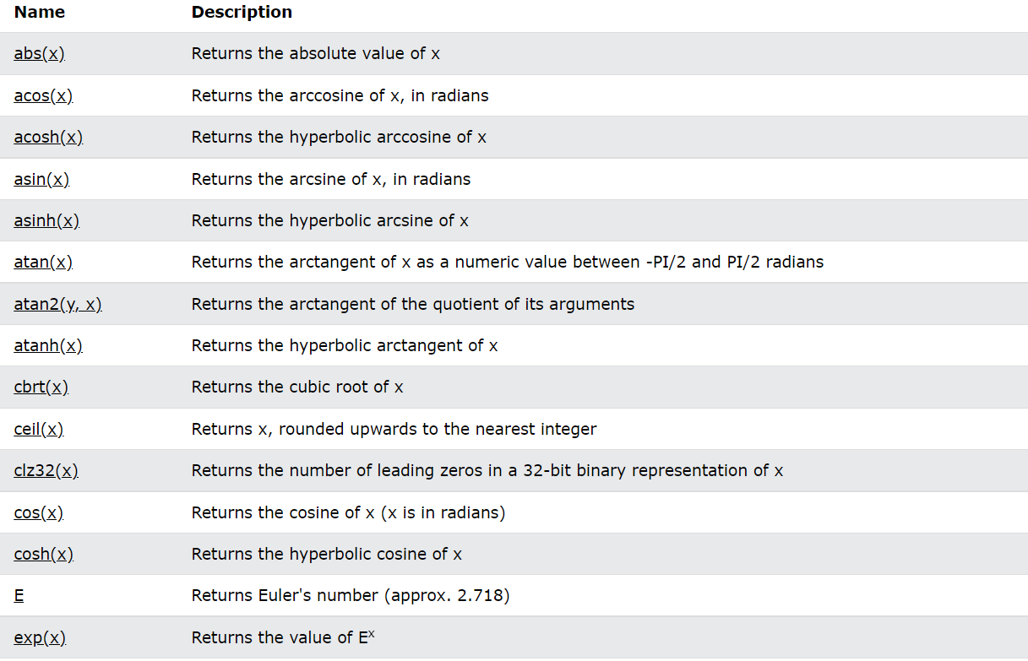
Math Object Methods and Properties

Slide 74
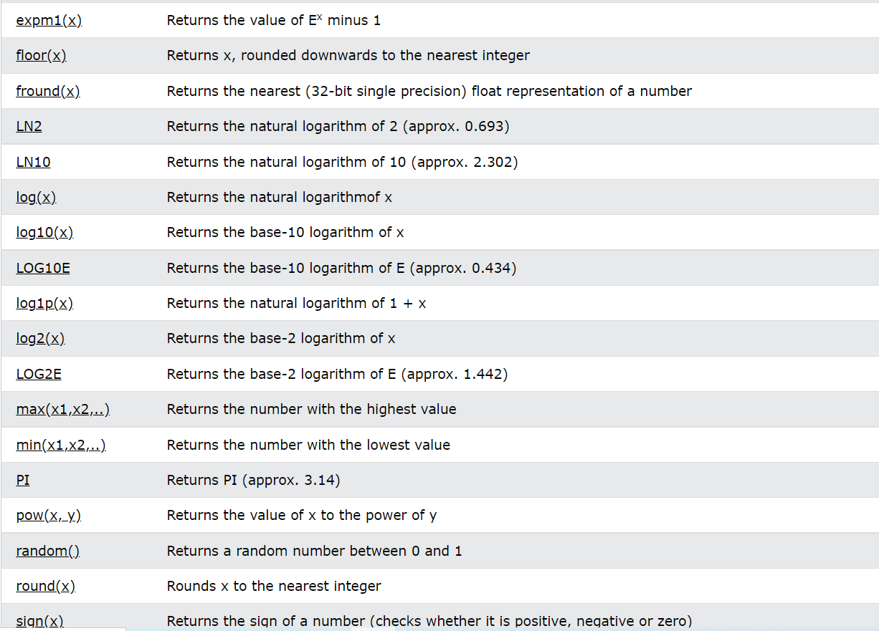
Math Object Methods and Properties

Slide 75
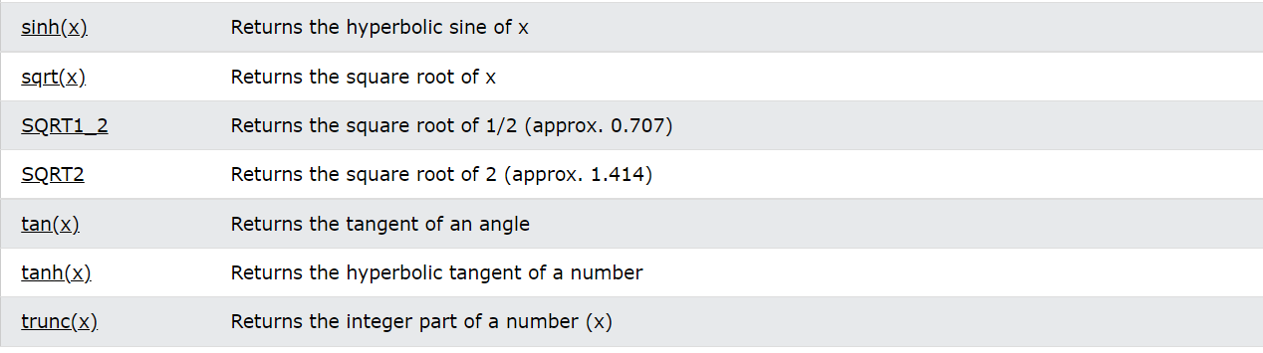
Math Object Methods and Properties

Slide 76
Math Random
Math.random() returns a random number between 0 (inclusive), and 1 (exclusive):
Example
// Returns a random number:
Math.random();
Math.random() always returns a number lower than 1.
JavaScript Random Integers
Math.random() used with Math.floor() can be used to return random integers.
// Returns a random integer from 0 to 9:
Math.floor(Math.random() * 10);
// Returns a random integer from 0 to 10:
Math.floor(Math.random() * 11);
// Returns a random integer from 0 to 99:
Math.floor(Math.random() * 100);

Slide 77
Math Random
// Returns a random integer from 0 to 100:
Math.floor(Math.random() * 101);
// Returns a random integer from 1 to 10:
Math.floor(Math.random() * 10) + 1;
// Returns a random integer from 1 to 100:
Math.floor(Math.random() * 100) + 1;
This JavaScript function always returns a random number between min (included) and max (excluded):
function getRndInteger(min, max) {
return Math.floor(Math.random() * (max - min) ) + min;
}
This JavaScript function always returns a random number between min and max (both included):
function getRndInteger(min, max) {
return Math.floor(Math.random() * (max - min + 1) ) + min;
}

Slide 78
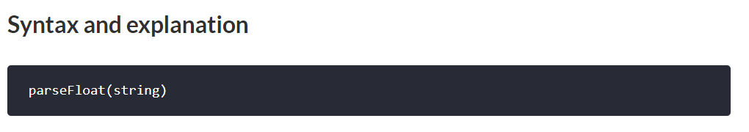
parseFloat
The parseFloat() function is used to accept a string and convert it into a floating-point number. If the input string does not contain a numeral value or If the first character of the string is not a number then it returns NaN i.e, not a number. This function returns a floating-point number parsed up to that point where it encounters a character that is not a number.
Parameters>: This function accepts a single parameter as mentioned above and described below:
String: This parameter, a mandatory input contains a string that is converted to a floating-point number.
Return value: It returns a floating-point Number and if the first character of a string cannot be converted to a number then the function returns NaN i.e, >not a number.

Slide 79
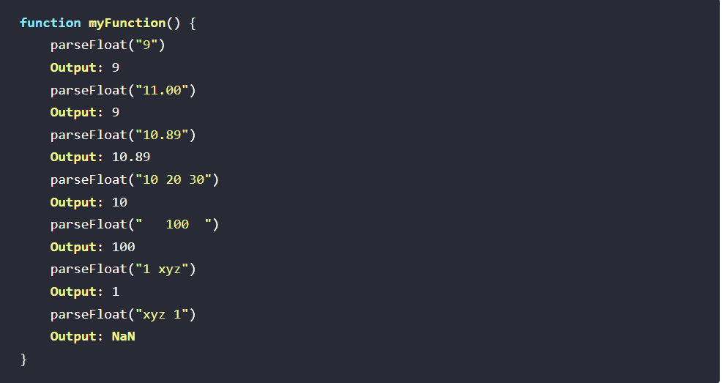
Example-parseFloat

Slide 80
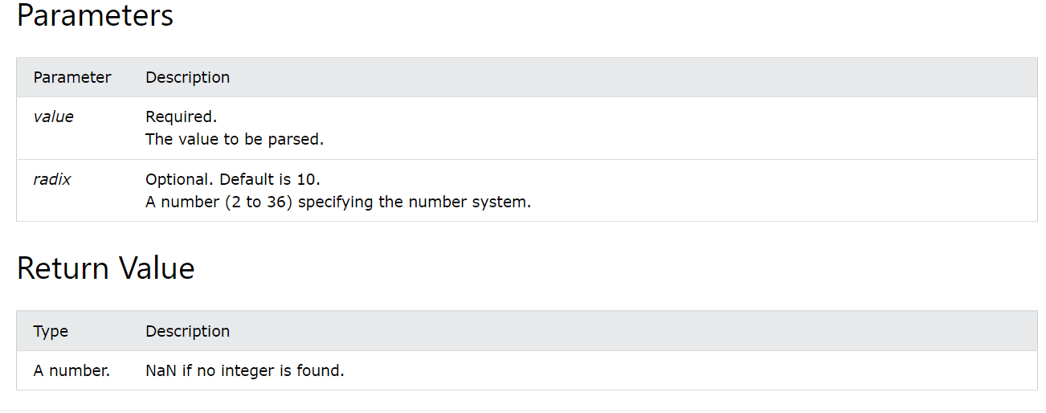
parseInt
The parseInt method parses a value as a string and returns the first integer.
Syntax
parseInt(string, radix)

Slide 81
Examples-parseInt
1) parseInt("10"); 2) parseInt("10.00"); 3) parseInt("10.33"); 4) parseInt("34 45 66"); 5) parseInt(" 60 "); 6) parseInt("40 years"); 7) parseInt("He was 40");
Output:
parseInt() parses a string and returns the first integer:
1) 10
2) 10
3) 10
4) 34
5) 60
6) 40
7) NaN

Slide 82
typeof Operator
Typeof in JavaScript is an operator used for type checking and returns the data type of the operand passed to it.
The operand can be any variable, function, or object whose type you want to find out using the typeof operator.
Since JavaScript is a dynamically typed language, meaning you do not have to specify the type of variables when declaring them, the typeof operator comes in handy to check the data type before execution.
You can use the JavaScript typeof operator in the following two ways:
typeof operand
typeof (operand)

Slide 83
typeof Operator
Different Types of Operands We Can Check Using Typeof in JavaScript
We can use typeof in JavaScript to check the data type of the following operands:
Number
String
Undefined
Boolean
Object
Symbol
Function

Slide 84
typeof returns Number
console.log(typeof 12)
console.log(typeof -31)
console.log(typeof 0)
console.log(typeof 5.695)
console.log(typeof Infinity)
console.log(typeof NaN)
console.log(typeof parseInt(`86`))
console.log(typeof parseFloat(`40.05`))

Slide 85
typeof returns String
console.log(typeof '');
console.log(typeof 'Simplilearn');
console.log(typeof 'Welcome to JavaScript Bootcamp');
console.log(typeof '10');
console.log(typeof (typeof 15));
console.log(typeof String(20));

Slide 86
typeof returns Undefined
// undefined keyword
console.log(typeof undefined)
// Declared but undefined variable
let a
console.log(typeof a);
// Undefined variable
console.log(typeof v);

Slide 87
typeof returns Boolean
console.log(typeof true);
console.log(typeof false);
console.log(typeof Boolean(1));

Slide 88
Thank you!!

